Slide 1
GCBASIC
PIC16Fxxxx chip Family ( Legacy )
Part 8 – Show serial data

Slide 2
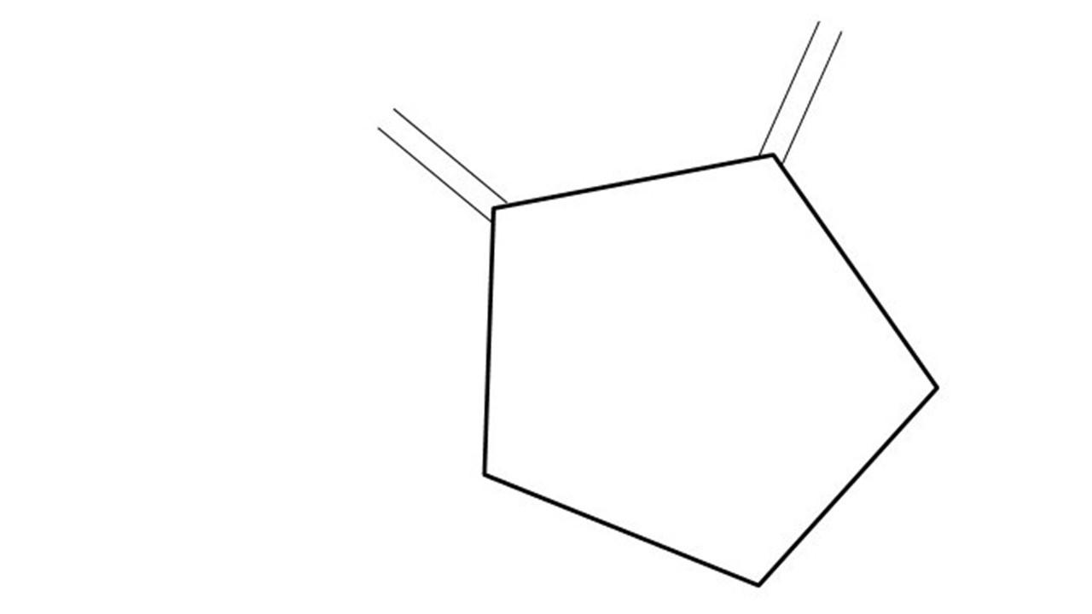
GCBASIC
PIC16Fxxxx chip Family ( Legacy )
Part 8 – Show serial data
January 2025

Slide 3
GCBASIC
Like and subscribe!

Slide 4
PIC16Fxxxx
PIC16Fxxxx is a high performance PIC16
Digital and Analog peripherals
8 –bit or 10-bit ADC
Multiple communication interfaces
Serial, I2C and SPI
PWM – CCP/PWM and 16Bit
The PIC16 offers 8, 14,18,20, 28, 40 and 48-pin packages to support customers in a wide variety of applications.

Slide 5
Videos...
Install the hardware and make the board work – make LEDs work
Make four LEDs flash in a sequence
Set the LEDs to represent the value of ADC
Sequence the LEDs with a delay using the value of ADC
Using an input to set the state of the LEDs
Using the reset switch
Using the switch, ADC – make the LEDs flash in a sequence with reverse
Using the serial to display values
Using the timer0 overflow, 8bit timer, 16bit timer to flash the LEDs
Using EEProm – showing values on the serial terminal, and more constants insights
Using I2C with serial to discover I2C devices
Using an I2C GCLD display
Using a SPI GCLD display
Using PWM, many ways, to dim the LEDS
Using an external interrupt to control an LED
Using storage within the chip – Progmem, EEPROM and DATA blocks
The GCBASIC tool chain
Assembly , alternatives assemblers and MPLAB-X
Summary

Slide 6
GCBASIC Compiler
GCBASIC Compiler
GCBASIC is an Open Source compiler for PIC, AVR and LGT microcontrollers
GCBASIC supports the 16Fxxxx chip family

Slide 7
Prerequisites
Assumes you have
Installed the GCBASIC software
Installed your programmer software
Test that you have the PIC attached
You have the 4 LEDs operating
You have a POT connected
You have switches connected
You have USB/TTL serial converter

Slide 8
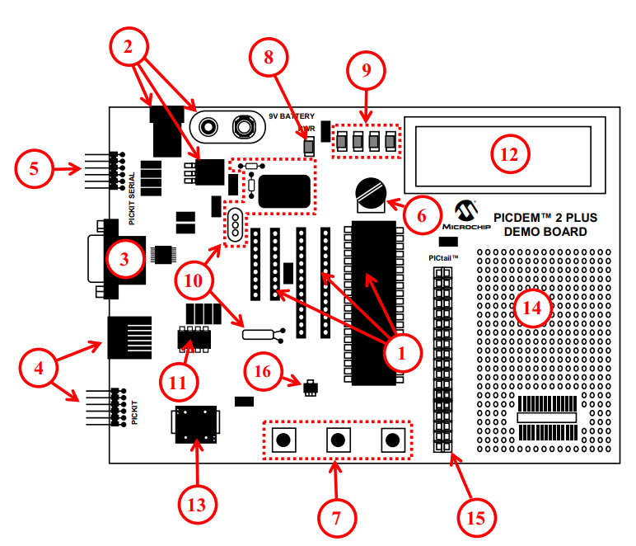
Hardware
The PICDEM 2 Plus Demonstration Board
18-, 28- and 40-pin DIP sockets (although three sockets are provided, only one device may be used at a time)
On-board, +5V regulator for direct input from 9V, 100 mA AC/DC wall adapter or 9V battery, or hooks for a +5V, 100 mA regulated DC supply
RS-232 socket and associated hardware for direct connection to an RS-232 interface
Programmer/debugger connectivity supporting MPLAB® ICD 3, MPLAB REAL ICE, PICkit 2 and PICkit 3
PICkit Serial Connector for analysis of serial communications peripherals such as SPI or I2C™
5 k pot for devices with analog inputs
Three push button switches for external stimulus and Reset
Power-on indicator LED
Four LEDs connected to PORTB
On-board external oscillators including: a) Unpopulated DIP socket for canned crystal oscillator (Y2) b) RC oscillator circuit (R4, C3) c) Unpopulated holes for crystal connection (Y1) d) 32.768 kHz crystal for Timer1 clock operation (Y3)
32K x 8 Serial EEPROM
LCD display
Piezo buzzer
Prototype area for user hardware
Expansion Header for PICtail™ daughter card connectivity or user access to
MCUs
Microchip TC74 thermal sensor

Slide 9

Hardware
TX
The PICDEM 2 Plus Demonstration Board
18-, 28- and 40-pin DIP sockets (although three sockets are provided, only one device may be used at a time)
On-board, +5V regulator for direct input from 9V, 100 mA AC/DC wall adapter or 9V battery, or hooks for a +5V, 100 mA regulated DC supply
RS-232 socket and associated hardware for direct connection to an RS-232 interface
Programmer/debugger connectivity supporting MPLAB® ICD 3, MPLAB REAL ICE, PICkit 2 and PICkit 3
PICkit Serial Connector for analysis of serial communications peripherals such as SPI or I2C™
5 k pot for devices with analog inputs
Three push button switches for external stimulus and Reset
Power-on indicator LED
Four LEDs connected to PORTB
On-board external oscillators including: a) Unpopulated DIP socket for canned crystal oscillator (Y2) b) RC oscillator circuit (R4, C3) c) Unpopulated holes for crystal connection (Y1) d) 32.768 kHz crystal for Timer1 clock operation (Y3)
32K x 8 Serial EEPROM
LCD display
Piezo buzzer
Prototype area for user hardware
Expansion Header for PICtail™ daughter card connectivity or user access to
MCUs
Microchip TC74 thermal sensor

Slide 10
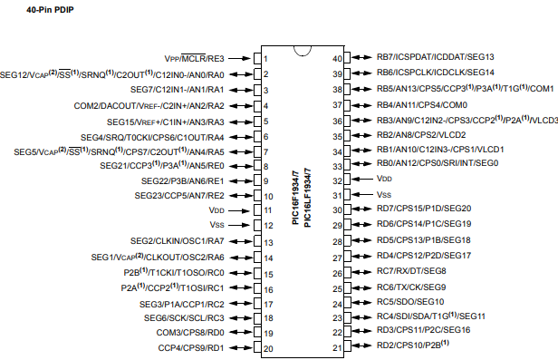
Hardware
TX

Slide 11
Hardware
Hardware
------------PORTA---------------
Bit#: -7---6---5---4---3---2---1---0---
IO: ------------SW2-------------ADC--
IO: ---------------------------------
------------PORTB----------------
Bit#: -7---6---5---4---3---2---1---0---
IO: ----------------LED-LED-LED-LED--
IO: ---------------------------------
------------PORTC----------------
Bit#: -7---6---5---4---3---2---1---0---
IO: ----TX---------------------------
IO: ---------------------------------
------------PORTD----------------
Bit#: -7---6---5---4---3---2---1---0---
IO: --------------------------------
IO: ---------------------------------
------------PORTE----------------
Bit#: -7---6---5---4---3---2---1---0---
IO: ----------------RST---------------
IO: ---------------------------------
Prototype Board
Power 5v0
Programmer
LEDs & resistors
Switches
TTL/USB

Slide 12
Serial output
Output
Using the built-in Universal Synchronous/Asynchronous Receiver Transmitter (USART) on the PIC® Microcontroller to communicate with serial terminal on a PC
Baseline is the tutorials so far, plus a TTL/USB serial converter

Slide 13
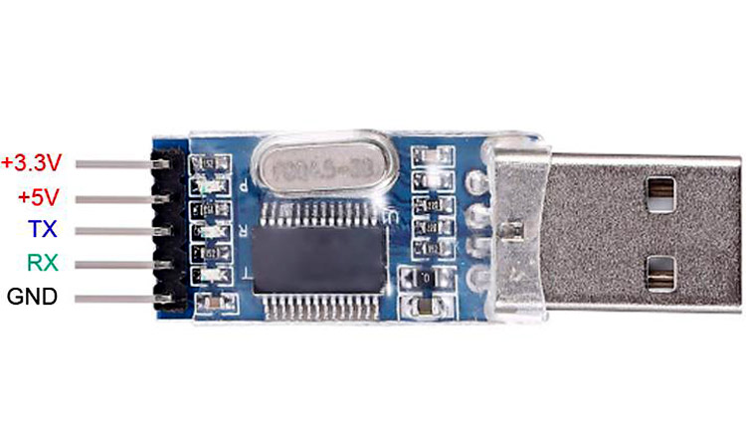
Serial output
GND and RX (RXD)

Slide 14
Tutorial overview
Initialise
Serial up the serial
Do Forever
ReadADC
Initialise
Setup the serial/USART
USART_BAUD_RATE
USART_TX_BLOCKING
USART_DELAY
Do forever
Read ADC
Send values to serial
Determine if switch state changed
Set state of LEDs
Wait
Loop
Send Values to Serial
Switch state changed
Right
Left
Set State of LEDs
Set State of LEDS
Wait

Slide 15
Lab #1
Examine the sample code
Review the results

Slide 17
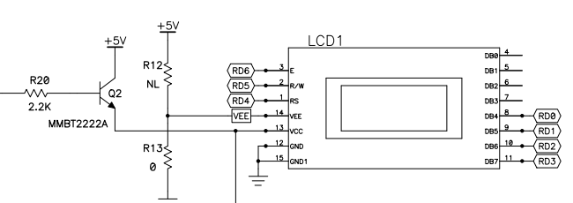

Lab #2
Use the LCD
Setup the LCD Parameters

Slide 18
Hardware
Hardware
------------PORTA---------------
Bit#: -7---6---5---4---3---2---1---0---
IO: ------------SW2-------------ADC--
IO: ---------------------------------
------------PORTB----------------
Bit#: -7---6---5---4---3---2---1---0---
IO: ----------------LED-LED-LED-LED--
IO: ---------------------------------
------------PORTC----------------
Bit#: -7---6---5---4---3---2---1---0---
IO: ----TX---------------------------
IO: ---------------------------------
------------PORTD----------------
Bit#: -7---6---5---4---3---2---1---0---
IO: -PWR-EN--RW--RS--DB7-DB6-DB5-DB4-
IO: ---------------------------------
------------PORTE----------------
Bit#: -7---6---5---4---3---2---1---0---
IO: ----------------RST---------------
IO: ---------------------------------
Prototype Board
Power 5v0
Programmer
LEDs & resistors
Switches
TTL/USB
LCD

Slide 20
Videos...
Install the hardware and make the board work – three LED programs
Make four LEDs flash in a sequence
Set the LEDs to represent the value of ADC
Sequence the LEDs with a delay using the value of ADC
Using an input to set the state of the LEDs
Using the reset switch
Using the switch, ADC – make the LEDs flash in a sequence with reverse
Using the serial to display values
Using the timer0 overflow, 8bit timer, 16bit timer to flash the LEDs
Using EEProm – showing values on the serial terminal, and more constants insights
Using I2C with serial to discover I2C devices
Using an I2C GCLD display
Using a SPI GCLD display
Using PWM, 7 ways, to dim the LEDS
Using an external interrupt to control an LED
Using storage within the chip – Progmem, SAF memory, EEPROM and DATA blocks
Using CLC
The GCBASIC tool chain
Assembly , alternatives assemblers and MPLAB-X
Summary

Slide 21
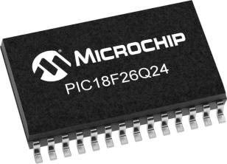
GCBASIC
PIC18FxxQ24
Part 8 - Show Serial Data

